Slide 1
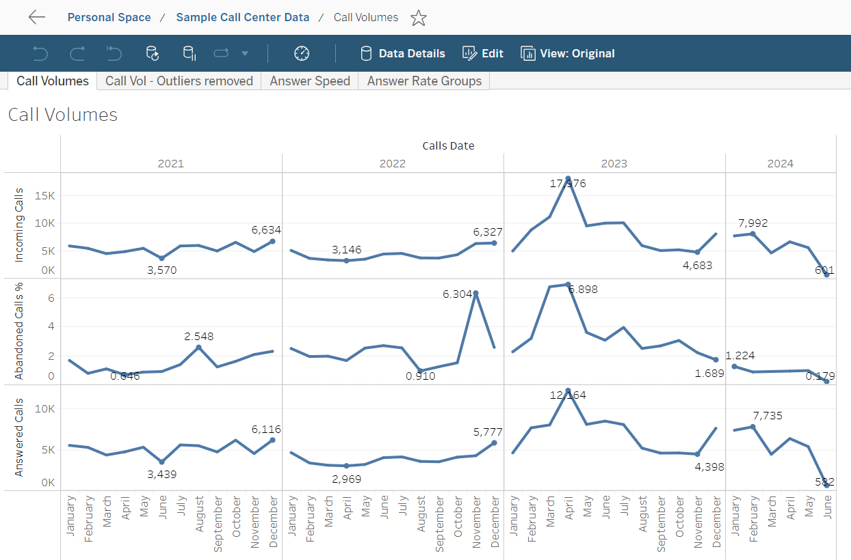
Call Volumes
Incoming & Answered volumes similar
2021 – 3.5k-6.5k
2022 – 3k-6.3k
2023 – 4.7k-11k
Except 18k spike in Mar
2024 – 4.5k-8k
Jun is just 4 days
Incoming & Answered call growth
Strong growth in 2023
2024 Similar volumes to 2023 except 3 spikes in 2023 Mar, Apr & May, and 2024 has lower abandoned calls % as well
Apr-16 to Apr-30:
Largest spikes in calls
Spike in Abandoned Calls will have a correlated negative impact on our customer satisfaction metrics
Investigating for possible IVR malfunctions & other potential drivers as well as
Abandon calls
2021 & 2022 – 1% to 2.5% except Nov 2022 (6.3%)
2023 – 1% to 4% except for spikes in Mar & Apr (about 7%)
2024 – 1%-1.2%

Slide 2
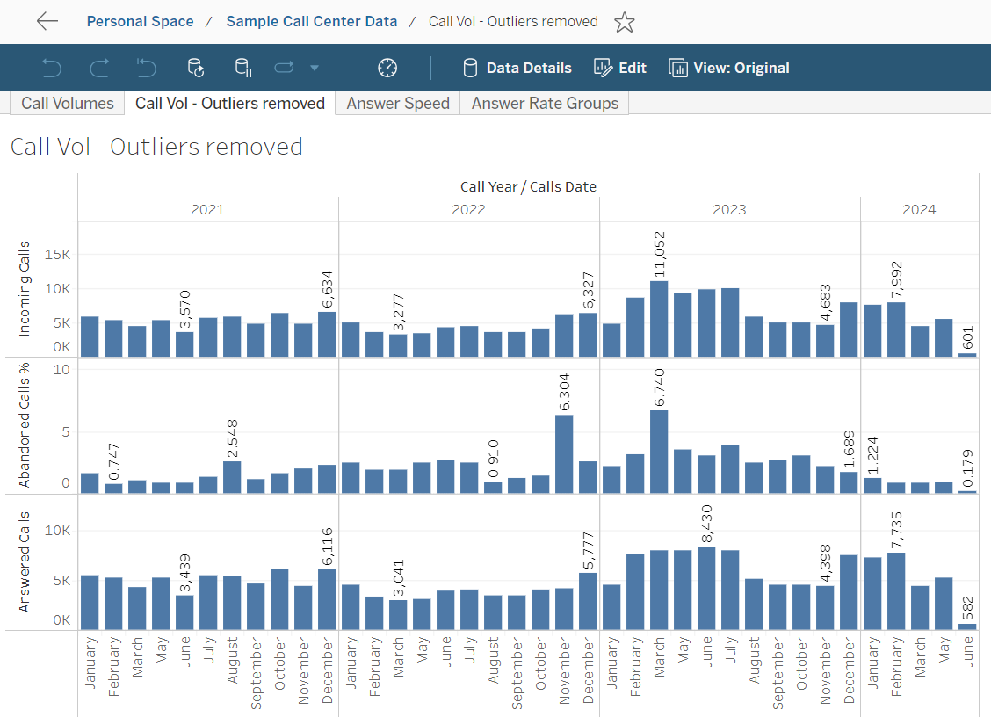
Call Vol - Apr Outlier removed
Incoming & Answered calls
2024 trends are still up with sustained larger call volumes (up to 8k) & with lower % of Abandoned Calls (below 1.5%)
Seasonality impacts by month are minimal
2024 trends are sustained larger call volumes are expected to drive sustained lager Sales volumes if sales per call rates stay consistent
Abandon calls
Spike are still in Nov-2022 (6.3%) & Mar-2023 (6.7%)
Spike in Abandoned Calls in Nov-2022 & Mar-2023 will be a leading indicator for their correlated negative impact on our customer satisfaction metrics

Slide 3
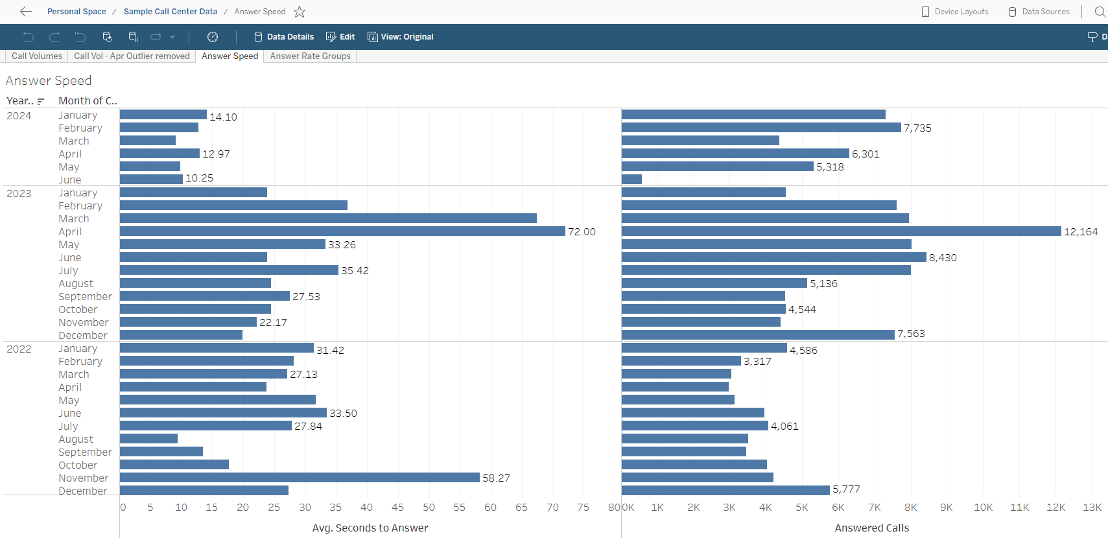
Answer Speed
Range of Answer Speed
2024 – 9-14 Seconds
2023 – 20-72 Seconds
2022 – 9-58 Seconds
Spikes in Avg Speeds
2024
No Spikes
9-14 Sec are all excellent Speeds
Mar-2023 – 67 Sec Spike
Apr-2023 – 72 Sec Spike
Nov-2022 – 58 Sec Spike
With Spikes removed
2024 – Low – Good
2023 – Too High – Even with Mar & Apr removed
2023 – Too High – Even with Nov removed

Slide 4
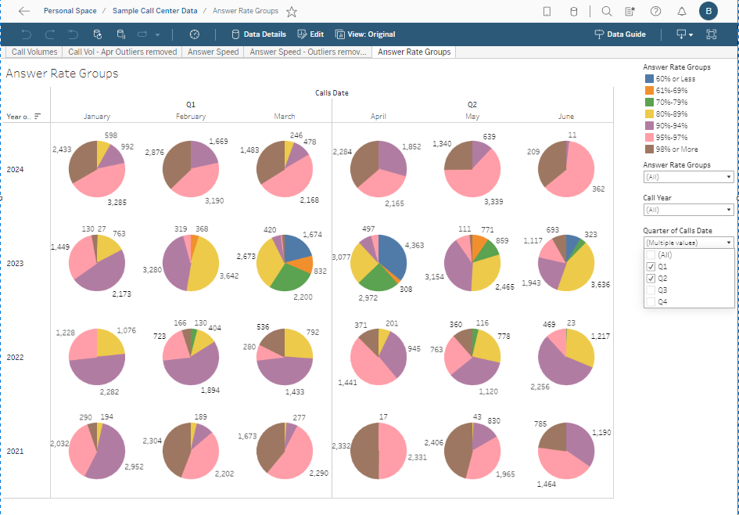
Answer Rate % Groups – Q1 & Q2
2024 – Answer Rate %
Is very high/good
Above 80% for all months
Above 90% for all months except Jan & Mar
Even Jan & Mar are still all in the above 80% range with only a minimal amount in the lower 80%-89% range
2023 – Answer Rate %
Majority are still above 80% for all months except Mar & Apr
Bad Answer Rate % Group mix/distribution for Mar & Apr directly attributed to the massive spike in calls creating a missive increase in answer speeds & dropped calls
2022 – Answer Rate %
Much better than 2023
Not as good as 2024

